Slide 1


Structure learning with deep neuronal networks
6th Network Modeling Workshop, 6/6/2013
Patrick Michl

Slide 2
Agenda
Biological Model
Validation & Implementation
Autoencoders

Slide 3
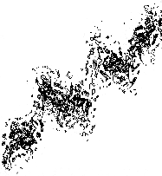
Autoencoders
Dataset
Model
x₂
x₁
Real world data usually is high dimensional …

Slide 4
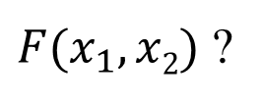
Autoencoders
Dataset
Model
x₁
x₂
$F(x_{1},x2)$ ?
x₂
x₁
… which makes structural analysis and modeling complicated!

Slide 5
Autoencoders
Dataset
Model
PCA
x₂
x₁
Dimensionality reduction techinques like PCA …

Slide 6

Autoencoders
Dataset
Model
PCA
x₁
x₂
$$x2=αx_{1}+β$$
x₂
x₁
… can not preserve complex structures!

Slide 7
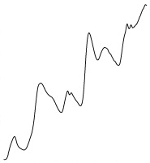
Autoencoders
Dataset
Model
x₂
x₁
Therefore the analysis of unknown structures …

Slide 8

Autoencoders
Dataset
Model
x₁
x₂
$$x2=f(x_{1})$$
x₂
x₁
… needs more considerate nonlinear techniques!

Slide 9
Autoencoders
Autoencoder
input data X
Artificial Neuronal Network
Perceptrons
Gaussian Units
output data X‘
Autoencoders are artificial neuronal networks …

Slide 10
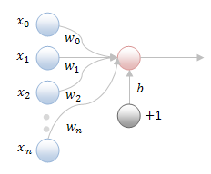

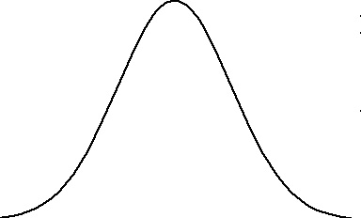
Autoencoders
Perceptron
input data X
Autoencoder
1
Artificial Neuronal Network
0
Perceptrons
Gaussian Units
Gauss Units
R
output data X‘
Autoencoders are artificial neuronal networks …

Slide 11
Autoencoders
Autoencoder
input data X
Artificial Neuronal Network
Perceptrons
Gaussian Units
output data X‘
Autoencoders are artificial neuronal networks …

Slide 12
Autoencoders
Autoencoder
input data X
Artificial Neuronal Network
Multiple hidden layers
Perceptrons
(Hidden layers)
Gaussian Units
(Visible layers)
output data X‘
… with multiple hidden layers.

Slide 13
Autoencoders
Autoencoder
input data X
Artificial Neuronal Network
Multiple hidden layers
Perceptrons
(Hidden layers)
Gaussian Units
(Visible layers)
output data X‘
Such networks are called deep networks.

Slide 14
Autoencoders
Autoencoder
input data X
Artificial Neuronal Network
Multiple hidden layers
Perceptrons
Definition (deep network)
(Hidden layers)
Deep networks are artificial neuronal networks with multiple hidden layers
Gaussian Units
(Visible layers)
output data X‘
Such networks are called deep networks.

Slide 15
Autoencoders
Autoencoder
input data X
Deep network
Perceptrons
(Hidden layers)
Gaussian Units
(Visible layers)
output data X‘
Such networks are called deep networks.

Slide 16
Autoencoders
Autoencoder
input data X
Deep network
Symmetric topology
Perceptrons
(Hidden layers)
Gaussian Units
(Visible layers)
output data X‘
Autoencoders have a symmetric topology …

Slide 17
Autoencoders
Autoencoder
input data X
Deep network
Symmetric topology
Perceptrons
(Hidden layers)
Gaussian Units
(Visible layers)
output data X‘
… with an odd number of hidden layers.

Slide 18
Autoencoders
Autoencoder
input data X
Deep network
Symmetric topology
Information bottleneck
Bottleneck
output data X‘
The small layer in the center works lika an information bottleneck

Slide 19
Autoencoders
Autoencoder
input data X
Deep network
Symmetric topology
Information bottleneck
Bottleneck
output data X‘
... that creates a low dimensional code for each sample in the input data.

Slide 20
Autoencoders
Autoencoder
input data X
Encoder
Deep network
Symmetric topology
Information bottleneck
Encoder
output data X‘
The upper stack does the encoding …

Slide 21
Autoencoders
Autoencoder
input data X
Encoder
Deep network
Symmetric topology
Information bottleneck
Encoder
Decoder
Decoder
output data X‘
… and the lower stack does the decoding.

Slide 22
Autoencoders
Autoencoder
input data X
Encoder
Deep network
Symmetric topology
Information bottleneck
Encoder
Decoder
Definition (deep network)
Definition (autoencoder)
Deep networks are artificial neuronal networks with multiple hidden layers
Autoencoders are deep networks with a symmetric topology and an odd number of hiddern layers, containing a encoder, a low dimensional representation and a decoder.
Decoder
output data X‘
… and the lower stack does the decoding.

Slide 23
Autoencoders
Autoencoder
input data X
Problem: dimensionality of data
Idea:
Train autoencoder to minimize the distance between input X and output X‘
Encode X to low dimensional code Y
Decode low dimensional code Y to output X‘
Output X‘ is low dimensional
output data X‘
Autoencoders can be used to reduce the dimension of data …

Slide 24
Autoencoders
Autoencoder
input data X
Problem: dimensionality of data
Idea:
Train autoencoder to minimize the distance between input X and output X‘
Encode X to low dimensional code Y
Decode low dimensional code Y to output X‘
Output X‘ is low dimensional
output data X‘
… if we can train them!

Slide 25
Autoencoders
Autoencoder
input data X
Training
Backpropagation
output data X‘
In feedforward ANNs backpropagation is a good approach.

Slide 26
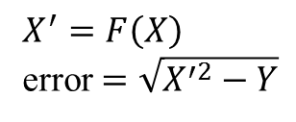
Autoencoders
Autoencoder
input data X
Training
Backpropagation
Backpropagation
Definition (autoencoder)
The distance (error) between current output X‘ and wanted output Y is computed. This gives a error function
$$X^{′}=F\left(X\right)$$
error $=\sqrt{X^{′2}−Y}$
output data X‘
In feedforward ANNs backpropagation is a good approach.

Slide 27
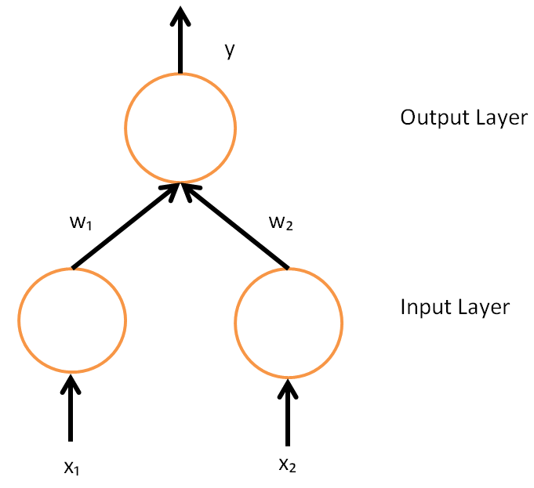
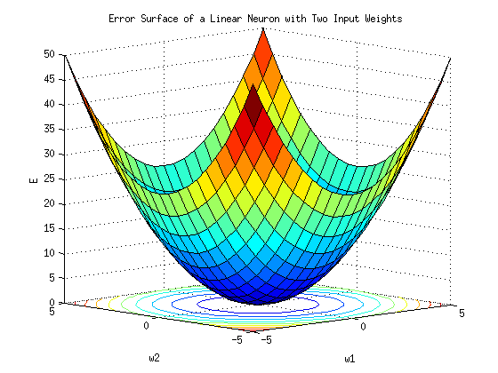
Autoencoders
Autoencoder
input data X
Training
Backpropagation
Backpropagation
Definition (autoencoder)
The distance (error) between current output X‘ and wanted output Y is computed. This gives a error function Example (linear neuronal unit with two inputs)
output data X‘
In feedforward ANNs backpropagation is the choice

Slide 28
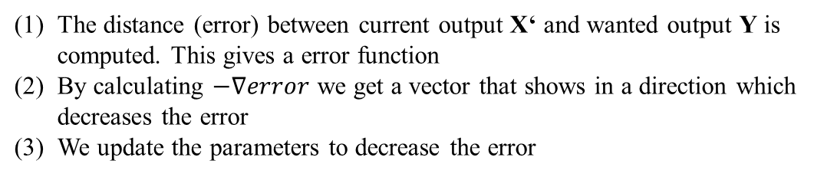
Autoencoders
Autoencoder
input data X
Training
Backpropagation
Backpropagation
Definition (autoencoder)
The distance (error) between current output X‘ and wanted output Y is computed. This gives a error function
By calculating $−∇error$ we get a vector that shows in a direction which decreases the error
We update the parameters to decrease the error
output data X‘
In feedforward ANNs backpropagation is a good approach.

Slide 29
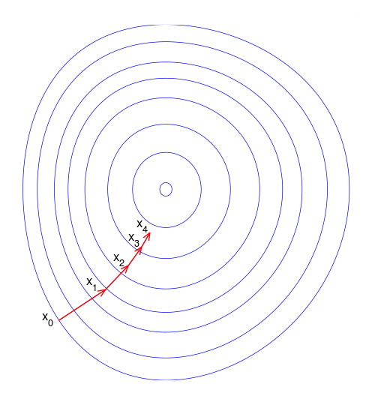
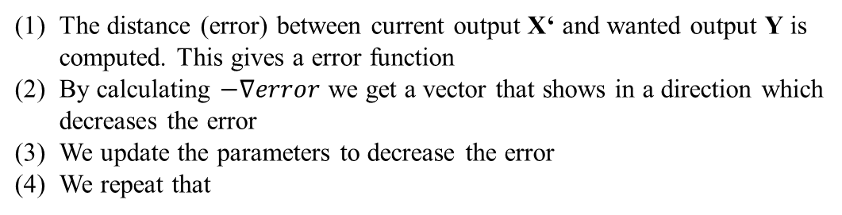
Autoencoders
Autoencoder
input data X
Training
Backpropagation
Backpropagation
Definition (autoencoder)
The distance (error) between current output X‘ and wanted output Y is computed. This gives a error function
By calculating $−∇error$ we get a vector that shows in a direction which decreases the error
We update the parameters to decrease the error
We repeat that
output data X‘
In feedforward ANNs backpropagation is the choice

Slide 30
Autoencoders
Autoencoder
input data X
Training
Backpropagation Problem: Deep Network
output data X‘
… the problem are the multiple hidden layers!

Slide 31
Autoencoders
Autoencoder
input data X
Training
Backpropagation Problem: Deep Network
Very slow training
output data X‘
Backpropagation is known to be slow far away from the output layer …

Slide 32
Autoencoders
Autoencoder
input data X
Training
Backpropagation Problem: Deep Network
Very slow training
Maybe bad solution
output data X‘
… and can converge to poor local minima.

Slide 33
Autoencoders
Autoencoder
input data X
Training
Backpropagation Problem: Deep Network
Very slow training
Maybe bad solution
Idea: Initialize close to a good solution
output data X‘
The task is to initialize the parameters close to a good solution!

Slide 34
Autoencoders
Autoencoder
input data X
Training
Backpropagation Problem: Deep Network
Very slow training
Maybe bad solution
Idea: Initialize close to a good solution
Pretraining
output data X‘
Therefore the training of autoencoders has a pretraining phase …

Slide 35
Autoencoders
Autoencoder
input data X
Training
Backpropagation Problem: Deep Network
Very slow training
Maybe bad solution
Idea: Initialize close to a good solution
Pretraining
Restricted Boltzmann Machines
output data X‘
… which uses Restricted Boltzmann Machines (RBMs)

Slide 36
Autoencoders
Autoencoder
input data X
Training
Restricted Boltzmann Machine
RBMs are Markov Random Fields
Backpropagation Problem: Deep Network
Very slow training
Maybe bad solution
Idea: Initialize close to a good solution
Pretraining
Restricted Boltzmann Machines
output data X‘
… which uses Restricted Boltzmann Machines (RBMs)

Slide 37
Autoencoders
Autoencoder
input data X
Training
Restricted Boltzmann Machine
RBMs are Markov Random Fields
Backpropagation Problem: Deep Network
Very slow training
Maybe bad solution
Idea: Initialize close to a good solution
Pretraining
Restricted Boltzmann Machines
Markov Random Field
Every unit influences every neighbor
The coupling is undirected
Motivation (Ising Model)
A set of magnetic dipoles (spins)
is arranged in a graph (lattice)
where neighbors are
coupled with a given strengt
output data X‘
… which uses Restricted Boltzmann Machines (RBMs)

Slide 38
Autoencoders
Autoencoder
input data X
Training
Restricted Boltzmann Machine
RBMs are Markov Random Fields
Bipartite topology: visible (v), hidden (h)
Use local energy to calculate the probabilities of values
Training:
contrastive divergency
(Gibbs Sampling)
Backpropagation Problem: Deep Network
Very slow training
Maybe bad solution
Idea: Initialize close to a good solution
Pretraining
Restricted Boltzmann Machines
v₁
v₂
v₃
v₄
output data X‘
h₁
h₂
h₃
… which uses Restricted Boltzmann Machines (RBMs)

Slide 39
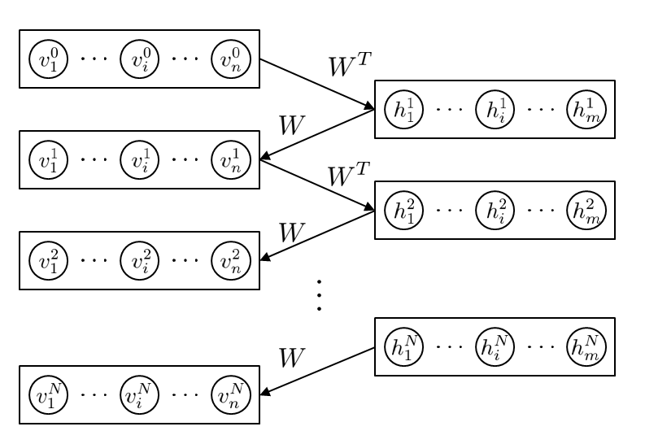
Autoencoders
Autoencoder
input data X
Training
Restricted Boltzmann Machine
Gibbs Sampling
Backpropagation Problem: Deep Network
Very slow training
Maybe bad solution
Idea: Initialize close to a good solution
Pretraining
Restricted Boltzmann Machines
output data X‘
… which uses Restricted Boltzmann Machines (RBMs)

Slide 40
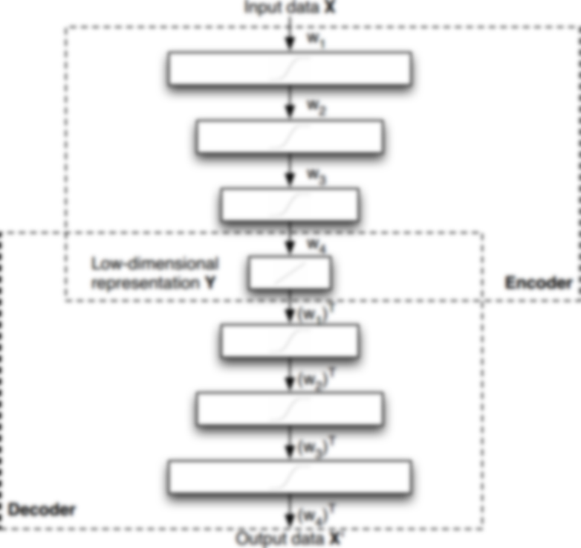
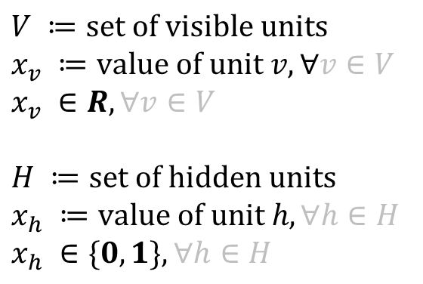
Autoencoders
Autoencoder
Training
Top
$$V ≔\text{set} \text{of} \text{visible} \text{units}$$
$$x_{v} ≔\text{value} \text{of} \text{unit} v,∀v∈V$$
$$x_{v} ∈R, ∀v∈V$$
$$H ≔\text{set} \text{of} \text{hidden} \text{units}$$
$$x_{h} ≔\text{value} \text{of} \text{unit} h, ∀h∈H$$
$$x_{h} ∈\{0, 1\}, ∀h∈H$$
The top layer RBM transforms real value data into binary codes.

Slide 41

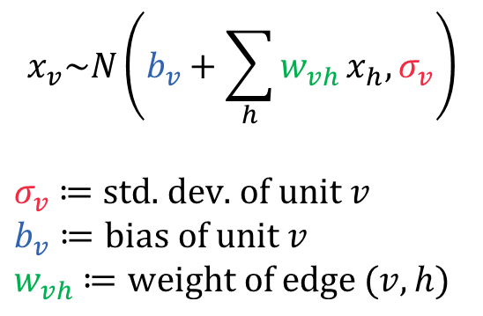
Autoencoders
Autoencoder
Training
Top
v₁
v₂
v₃
v₄
$$x_{v}\text{\sim }N\left(b_{v}+\sum_{h}{w_{vh}}x_{h},σ_{v}\right)$$
$σ_{v}$ $≔$ $\text{std}\text{. }\text{dev}\text{. }\text{of} \text{unit} v$
$$b_{v}≔\text{bias} \text{of} \text{unit} v$$
$w_{vh}$ $≔\text{weight} \text{of} \text{edge} \text{(}v,h)$
h₁
h₂
h₃
h₄
h₅
Therefore visible units are modeled with gaussians to encode data …

Slide 42

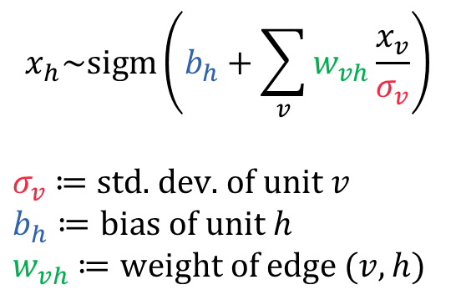
Autoencoders
Autoencoder
Training
Top
v₁
v₂
v₃
v₄
$$x_{h}\text{\sim }sigm\left(b_{h}+\sum_{v}{w_{vh}}\frac{x_{v}}{σ_{v}}\right)$$
$σ_{v}$ $≔$ $\text{std}\text{. }\text{dev}\text{. }\text{of} \text{unit} v$
$$b_{h}≔\text{bias} \text{of} \text{unit} h$$
$w_{vh}$ $≔\text{weight} \text{of} \text{edge}\text{ (}v,h)$
h₁
h₂
h₃
h₄
h₅
… and many hidden units with simoids to encode dependencies

Slide 43
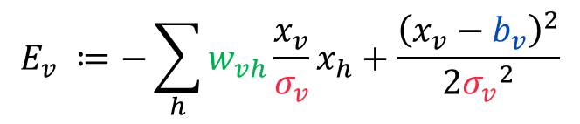
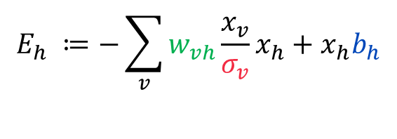
Autoencoders
Autoencoder
Training
Top
v₁
v₂
v₃
v₄
Local Energy
h₁
h₂
h₃
h₄
h₅
$$E_{v} ≔\text{−}\sum_{h}{w_{vh}}{\frac{x_{v}}{σ_{v}}x}_{h}+\frac{{\left(x_{v}−b_{v}\right)}^{2}}{2{σ_{v}}^{2}}$$
$$E_{h} ≔\text{−}\sum_{v}{w_{vh}}{\frac{x_{v}}{σ_{v}}x}_{h}+x_{h}b_{h}$$
The objective function is the sum of the local energies.

Slide 44
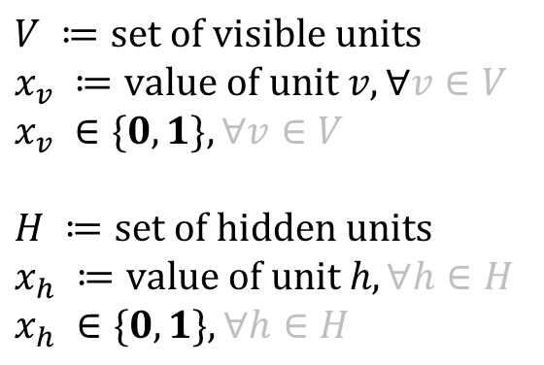
Autoencoders
Autoencoder
Training
Reduction
$$V ≔\text{set} \text{of} \text{visible} \text{units}$$
$$x_{v} ≔\text{value} \text{of} \text{unit} v,∀v∈V$$
$$x_{v} ∈\{0, 1\}, ∀v∈V$$
$$H ≔\text{set} \text{of} \text{hidden} \text{units}$$
$$x_{h} ≔\text{value} \text{of} \text{unit} h, ∀h∈H$$
$$x_{h} ∈\{0, 1\}, ∀h∈H$$
The next RBM layer maps the dependency encoding…

Slide 45
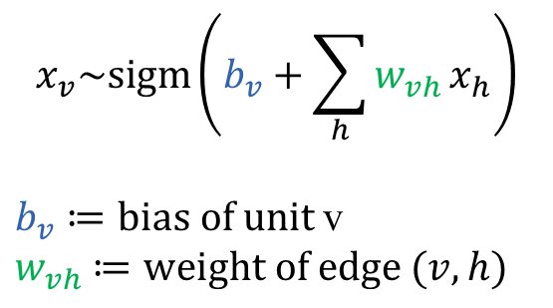
Autoencoders
Autoencoder
Training
Reduction
v₁
v₂
v₃
v₄
$$x_{v}\text{\sim }sigm\left(b_{v}+\sum_{h}{w_{vh}}x_{h}\right)$$
$b_{v}≔\text{bias} \text{of} \text{unit}$v
$w_{vh}$ $≔\text{weight} \text{of} \text{edge}\text{ (}v,h)$
h₁
h₂
h₃
… from the upper layer …

Slide 46

Autoencoders
Autoencoder
Training
Reduction
v₁
v₂
v₃
v₄
$$x_{h}\text{\sim }sigm\left(b_{h}+\sum_{v}{w_{vh}}x_{v}\right)$$
$b_{h}≔\text{bias} \text{of} \text{unit}$h
$w_{vh}$ $≔\text{weight} \text{of} \text{edge}\text{ (}v,h)$
h₁
h₂
h₃
… to a smaller number of simoids …

Slide 47

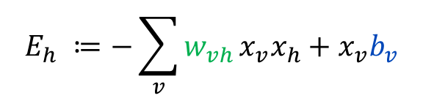
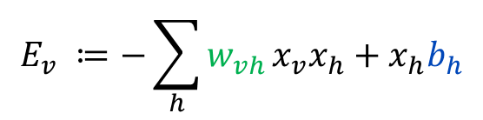
Autoencoders
Autoencoder
Training
Reduction
v₁
v₂
v₃
v₄
Local Energy
$$E_{v} ≔\text{−}\sum_{h}{w_{vh}}{x_{v}x}_{h}+x_{h}b_{h}$$
h₁
h₂
h₃
$$E_{h} ≔\text{−}\sum_{v}{w_{vh}}{x_{v}x}_{h}+x_{v}b_{v}$$
… which can be trained faster than the top layer

Slide 48
Autoencoders
Autoencoder
Training
Unrolling
The symmetric topology allows us to skip further training.

Slide 49
Autoencoders
Autoencoder
Training
Unrolling
The symmetric topology allows us to skip further training.

Slide 50
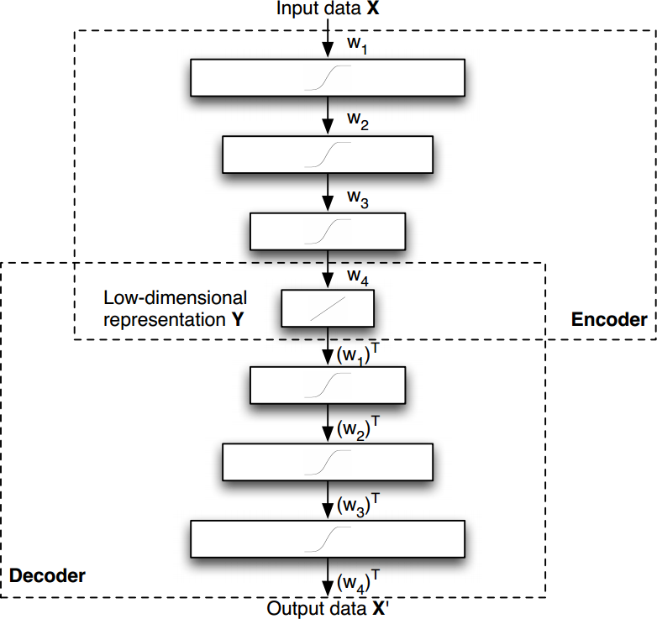
Autoencoders
Autoencoder
Training
Pretraining Top RBM (GRBM) Reduction RBMs Unrolling
Finetuning Backpropagation
After pretraining backpropagation usually finds good solutions

Slide 51
Autoencoders
Autoencoder
Training
Complexity: O(inw) i: number of iterations n: number of nodes w: number of weights
Memory Complexity: O(w)
The algorithmic complexity of RBM training depends on the network size

Slide 52
Agenda
Biological Model
Validation & Implementation
Autoencoders

Slide 53
Network Modeling Restricted Boltzmann Machines (RBM)
S
TF
E
How to model the topological structure?

Slide 54
Network Modeling Restricted Boltzmann Machines (RBM)
S
TF
E
We define S and E as visible data Layer …

Slide 55
Network Modeling Restricted Boltzmann Machines (RBM)
S
E
TF
We identify S and E with the visible layer …

Slide 56
Network Modeling Restricted Boltzmann Machines (RBM)
S
E
TF
… and the TFs with the hidden layer in a RBM

Slide 57
Network Modeling Restricted Boltzmann Machines (RBM)
S
E
TF
The training of the RBM gives us a model

Slide 58
Agenda
Autoencoder
Biological Model
Implementation & Results

Slide 59
Results
Validation of the results
Needs information about the true regulation
Needs information about the descriptive power of the data

Slide 60
Results
Validation of the results
Needs information about the true regulation
Needs information about the descriptive power of the data
Without this infomation validation can only be done,
using artificial datasets!

Slide 61
Results
Artificial datasets
We simulate data in three steps:

Slide 62
Results
Artificial datasets
We simulate data in three steps
Step 1
Choose number of Genes (E+S) and create random bimodal distributed data

Slide 63
Results
Artificial datasets
We simulate data in three steps
Step 1
Choose number of Genes (E+S) and create random bimodal distributed data Step 2
Manipulate data in a fixed order

Slide 64
Results
Artificial datasets
We simulate data in three steps
Step 1
Choose number of Genes (E+S) and create random bimodal distributed data Step 2
Manipulate data in a fixed order
Step 3
Add noise to manipulated data
and normalize data

Slide 65
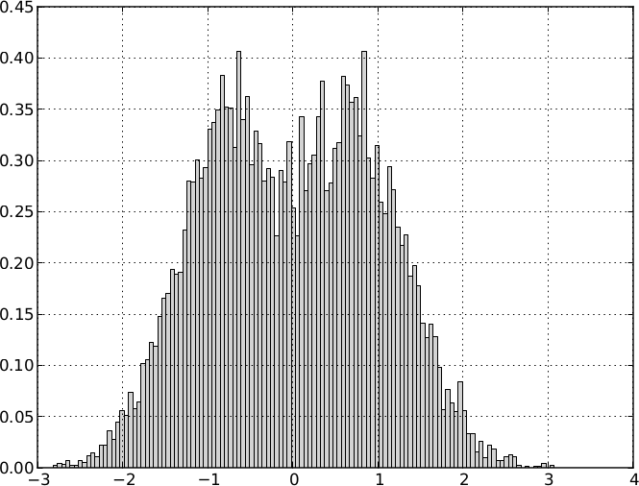
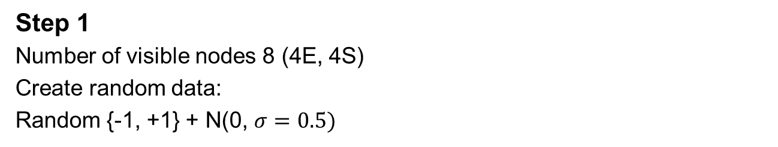
Results
Simulation
Step 1
Number of visible nodes 8 (4E, 4S)
Create random data:
Random {-1, +1} + N(0, $σ=0.5)$

Slide 66
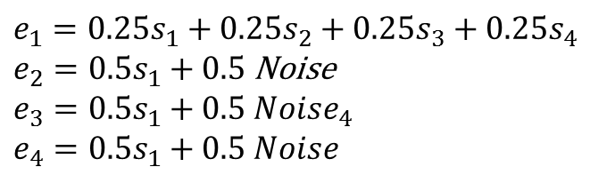
Results
Simulation
Step 2
Manipulate data
$$e_{1}=0.25s_{1}+0.25s_{2}+0.25s_{3}+{0.25s}_{4}$$
$e_{2}=0.5s_{1}+0.5$ Noise
$$e_{3}=0.5s_{1}+0.5{ Noise}_{4}$$
$$e_{4}=0.5s_{1}+0.5 Noise$$

Slide 67
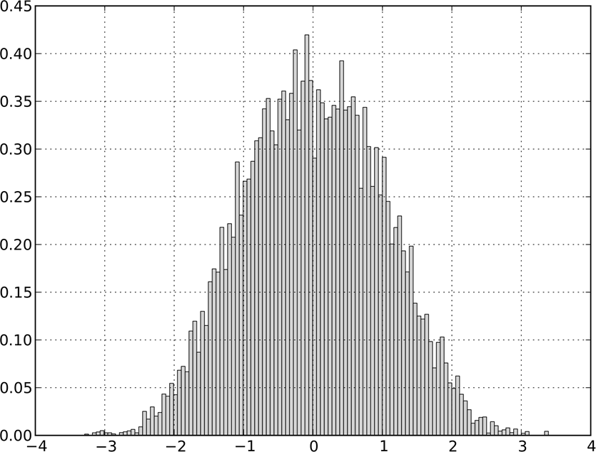

Results
Simulation
Step 3
Add noise: N(0, $σ=0.5)$

Slide 68
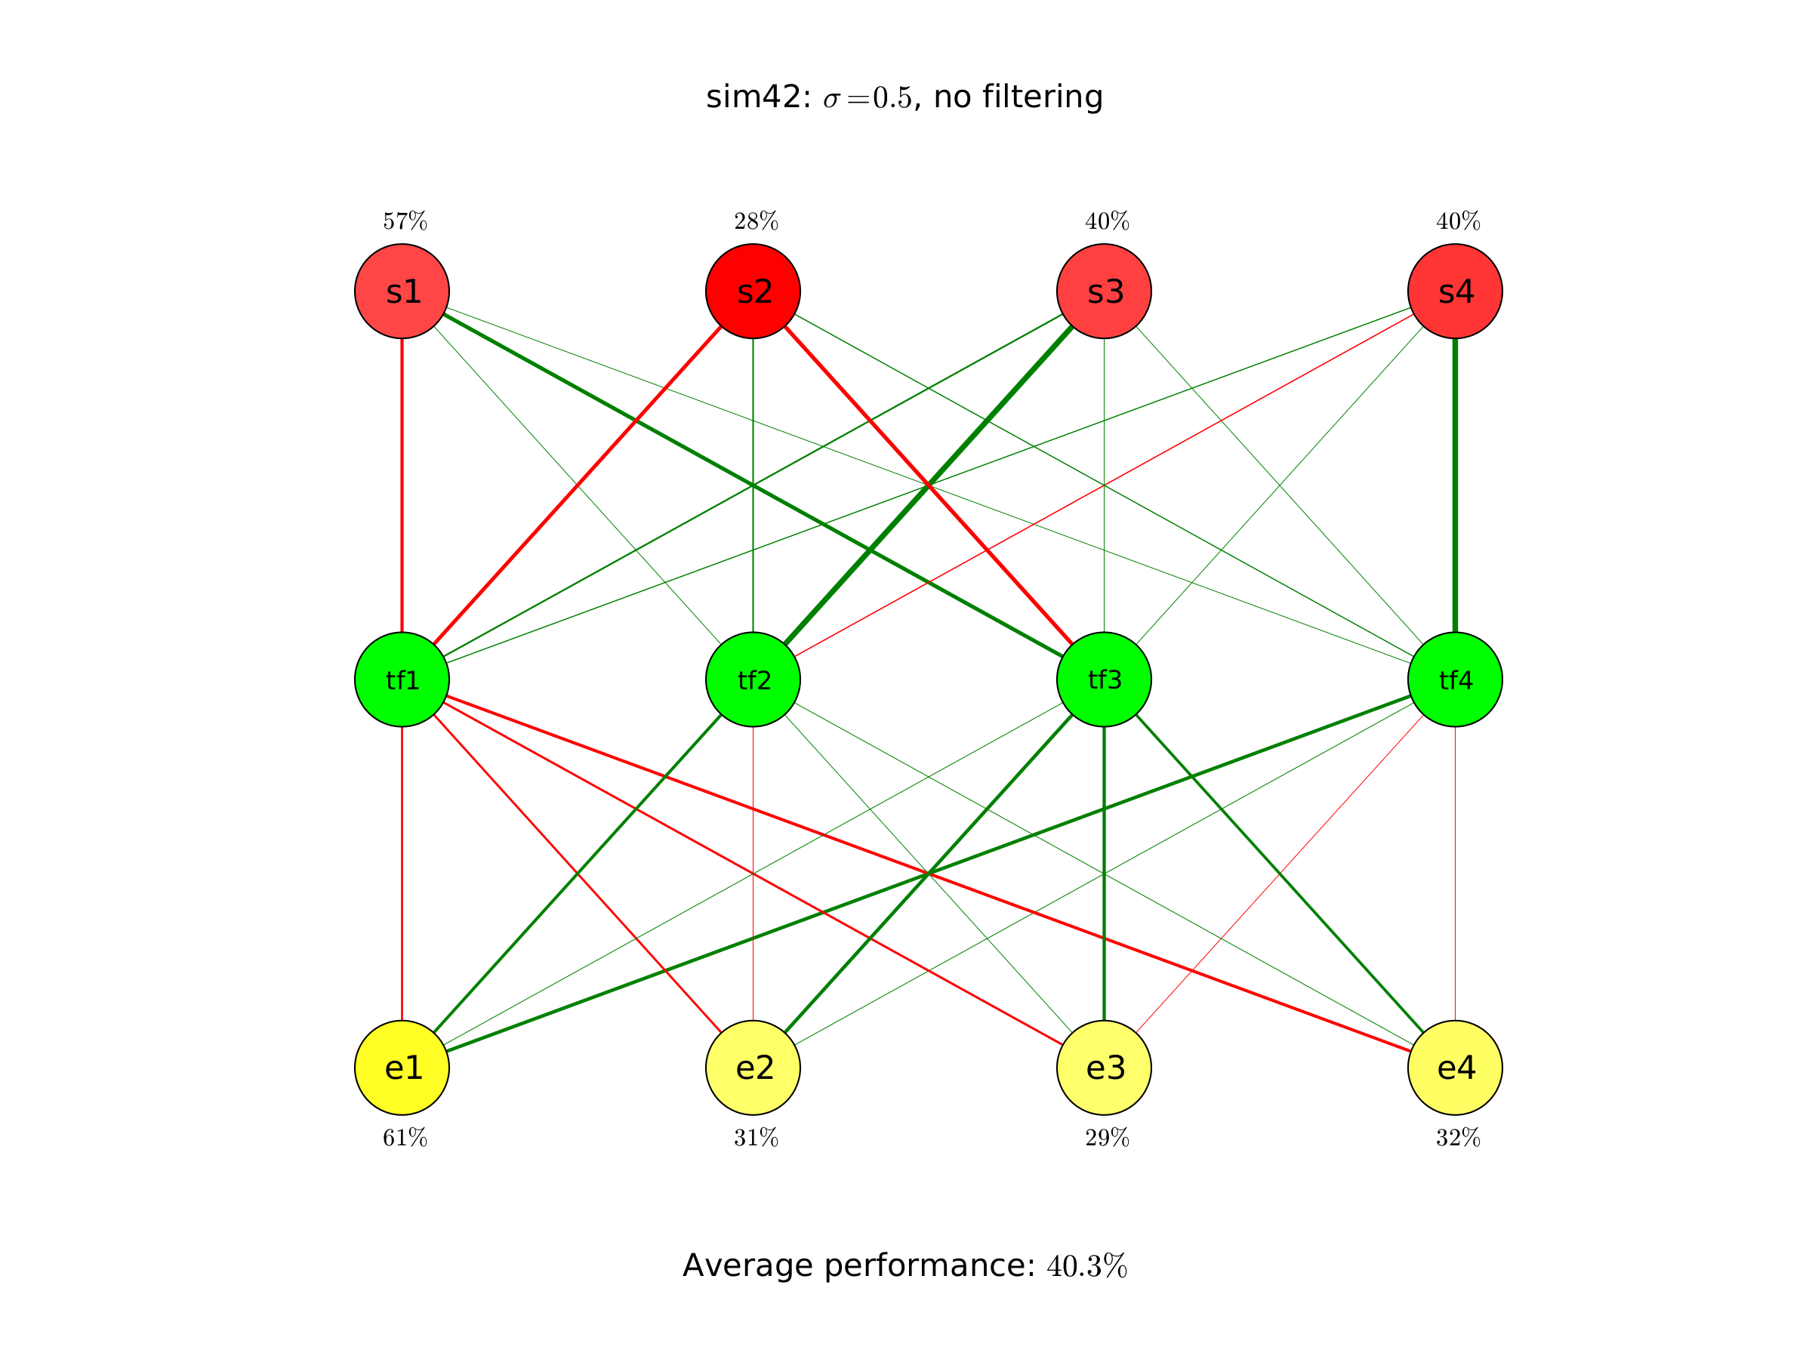
Results
We analyse the data X
with an RBM

Slide 69
Results
We train an autoencoder with 9 hidden layers
and 165 nodes:
Layer 1 & 9: 32 hidden units
Layer 2 & 8: 24 hidden units
Layer 3 & 7: 16 hidden units
Layer 4 & 6: 8 hidden units
Layer 5: 5 hidden units
input data X
output data X‘

Slide 70
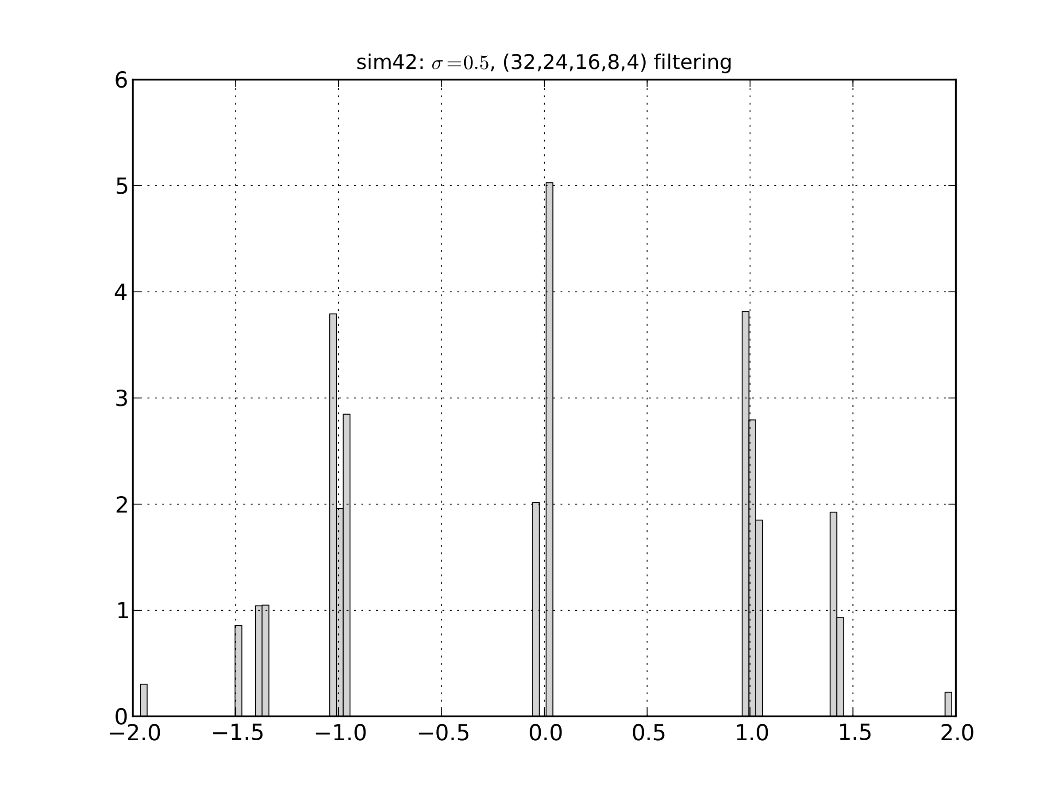
Results
We transform the data from X to X‘
And reduce the dimensionality

Slide 71
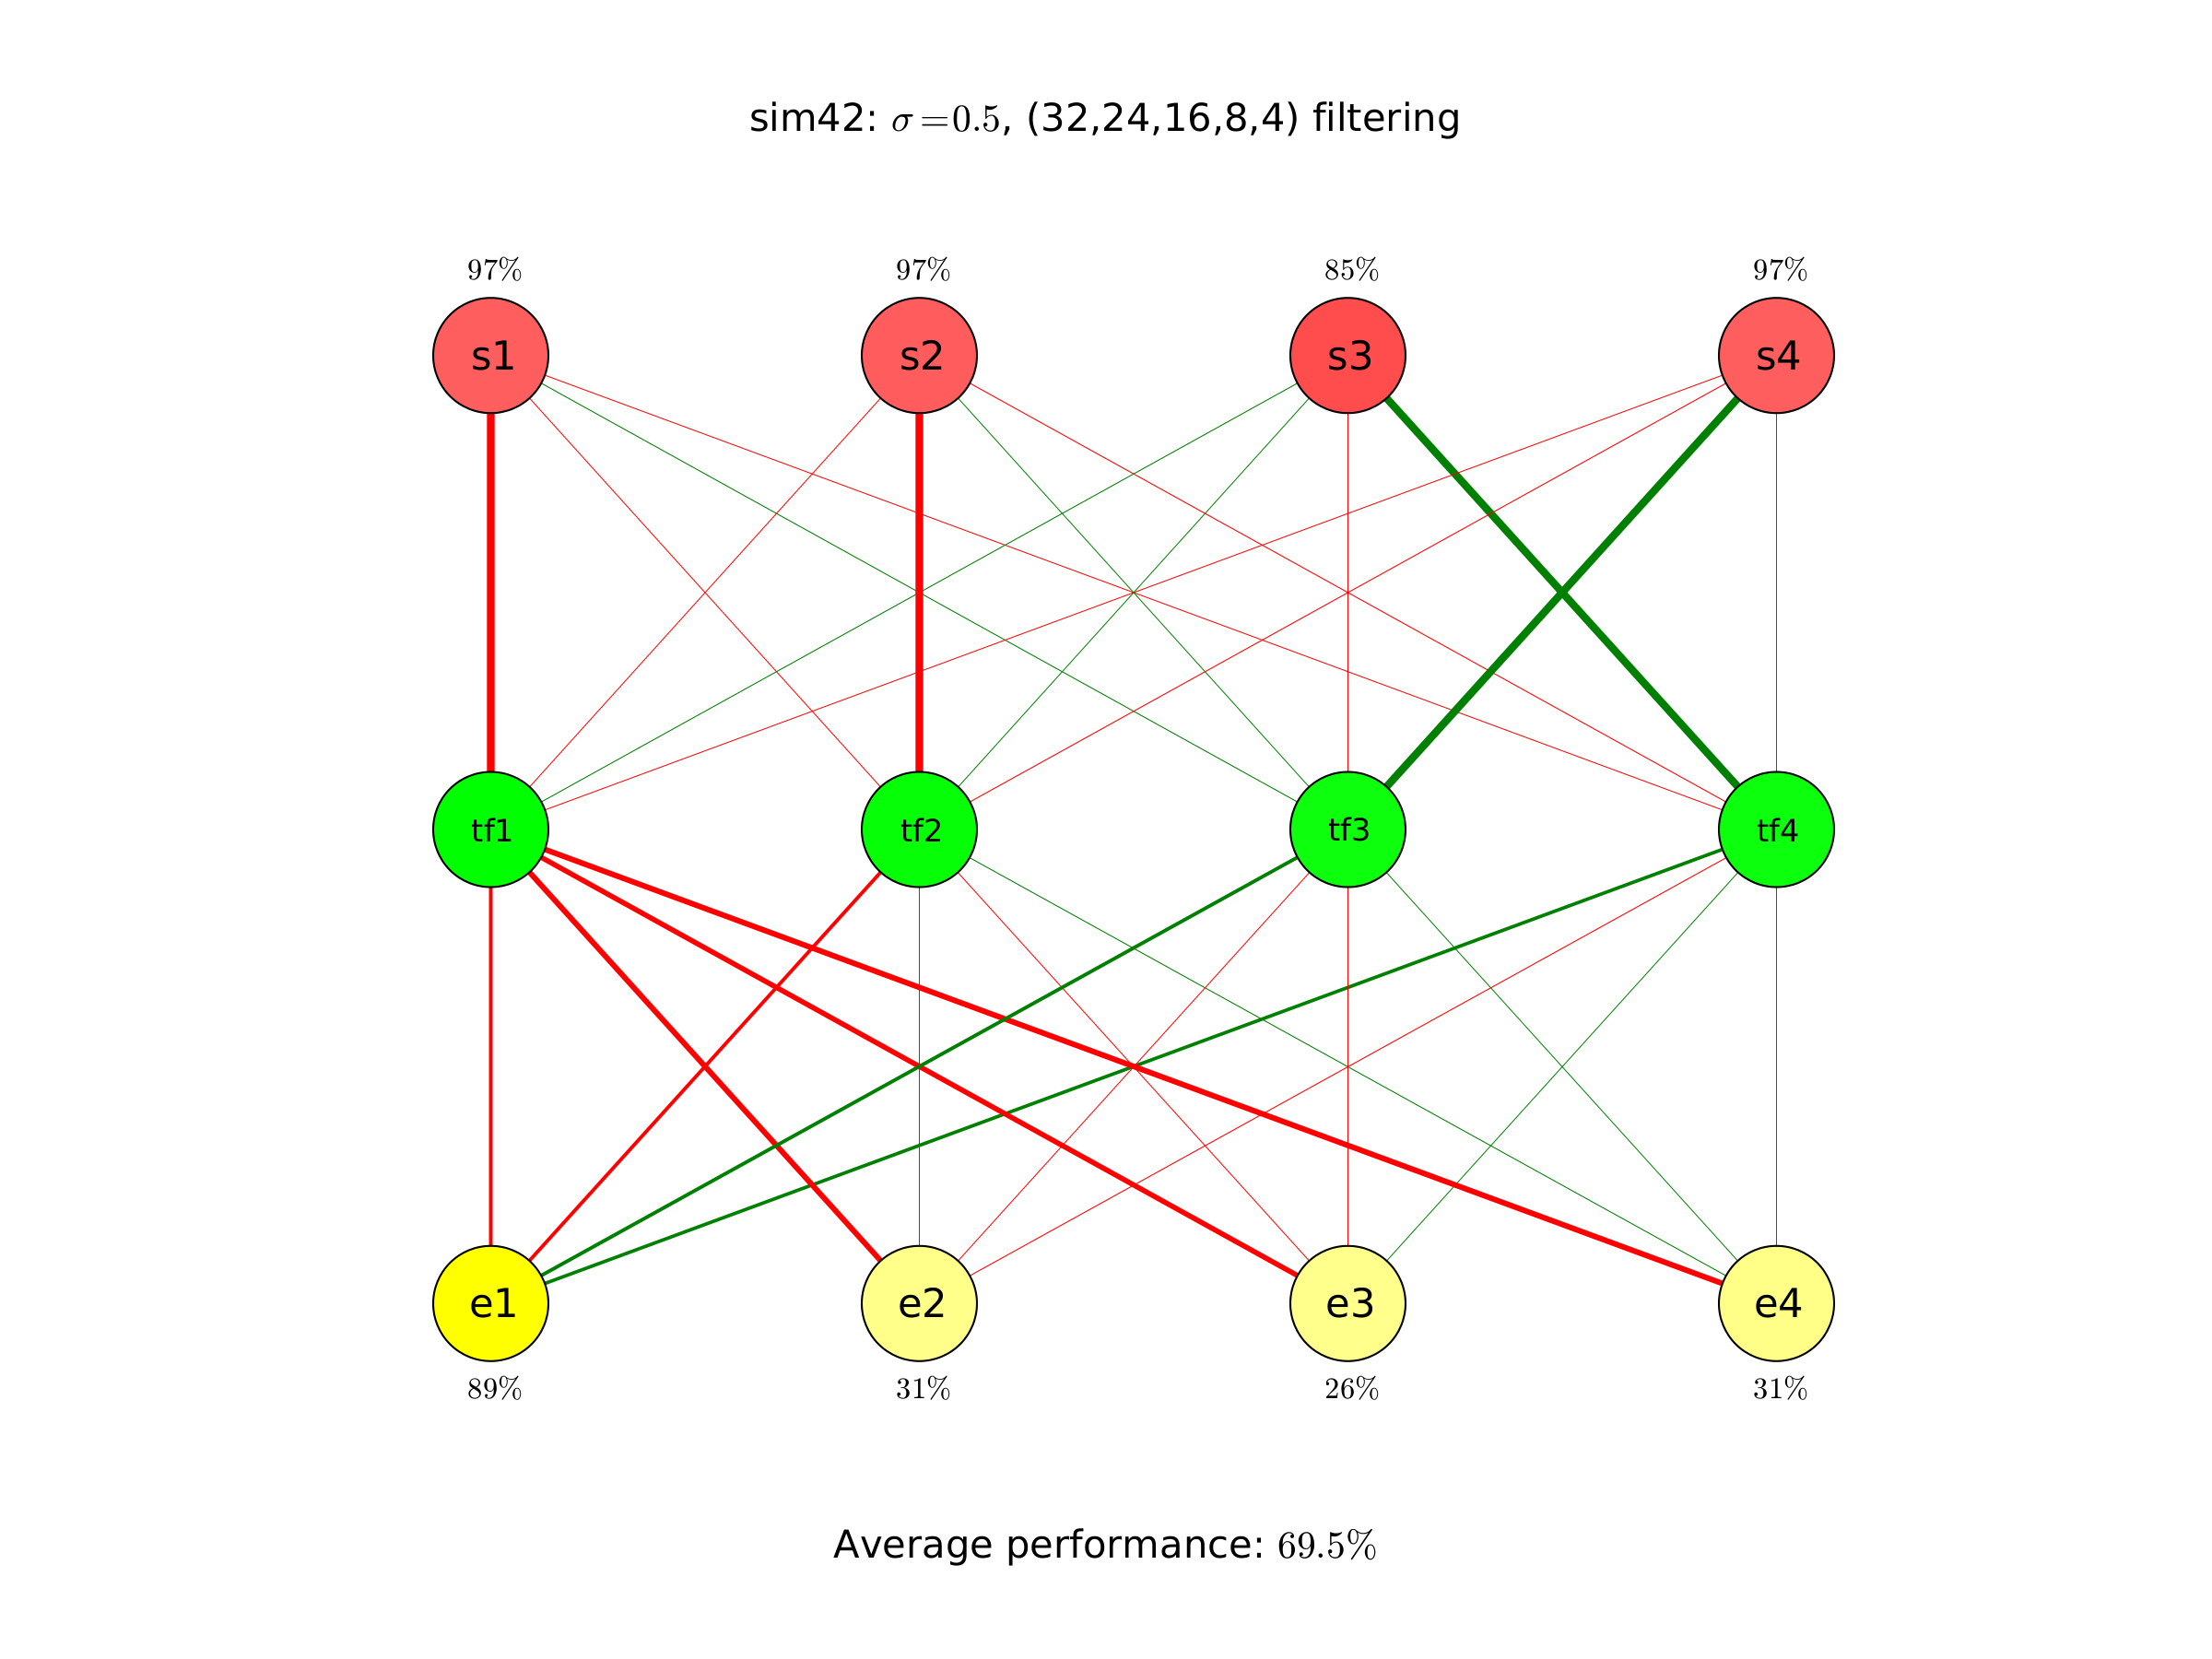
Results
We analyse the
transformed data X‘
with an RBM

Slide 72
Results
Lets compare the models

Slide 73
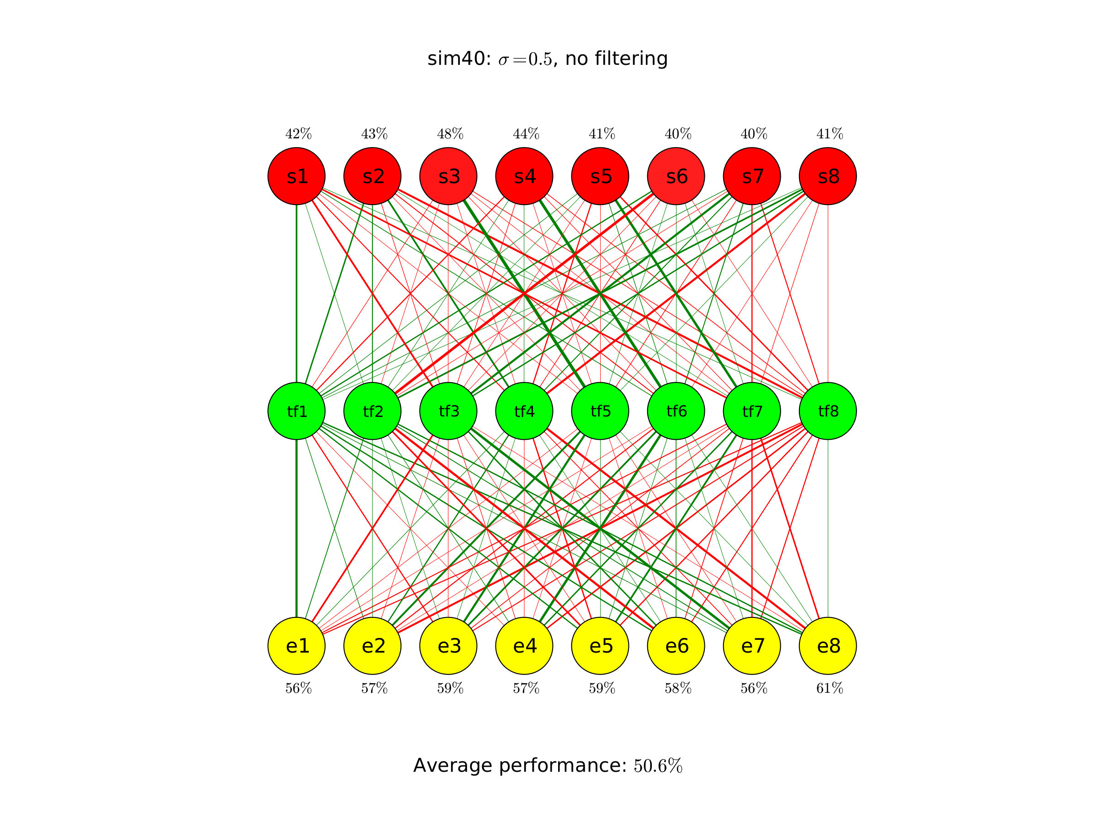
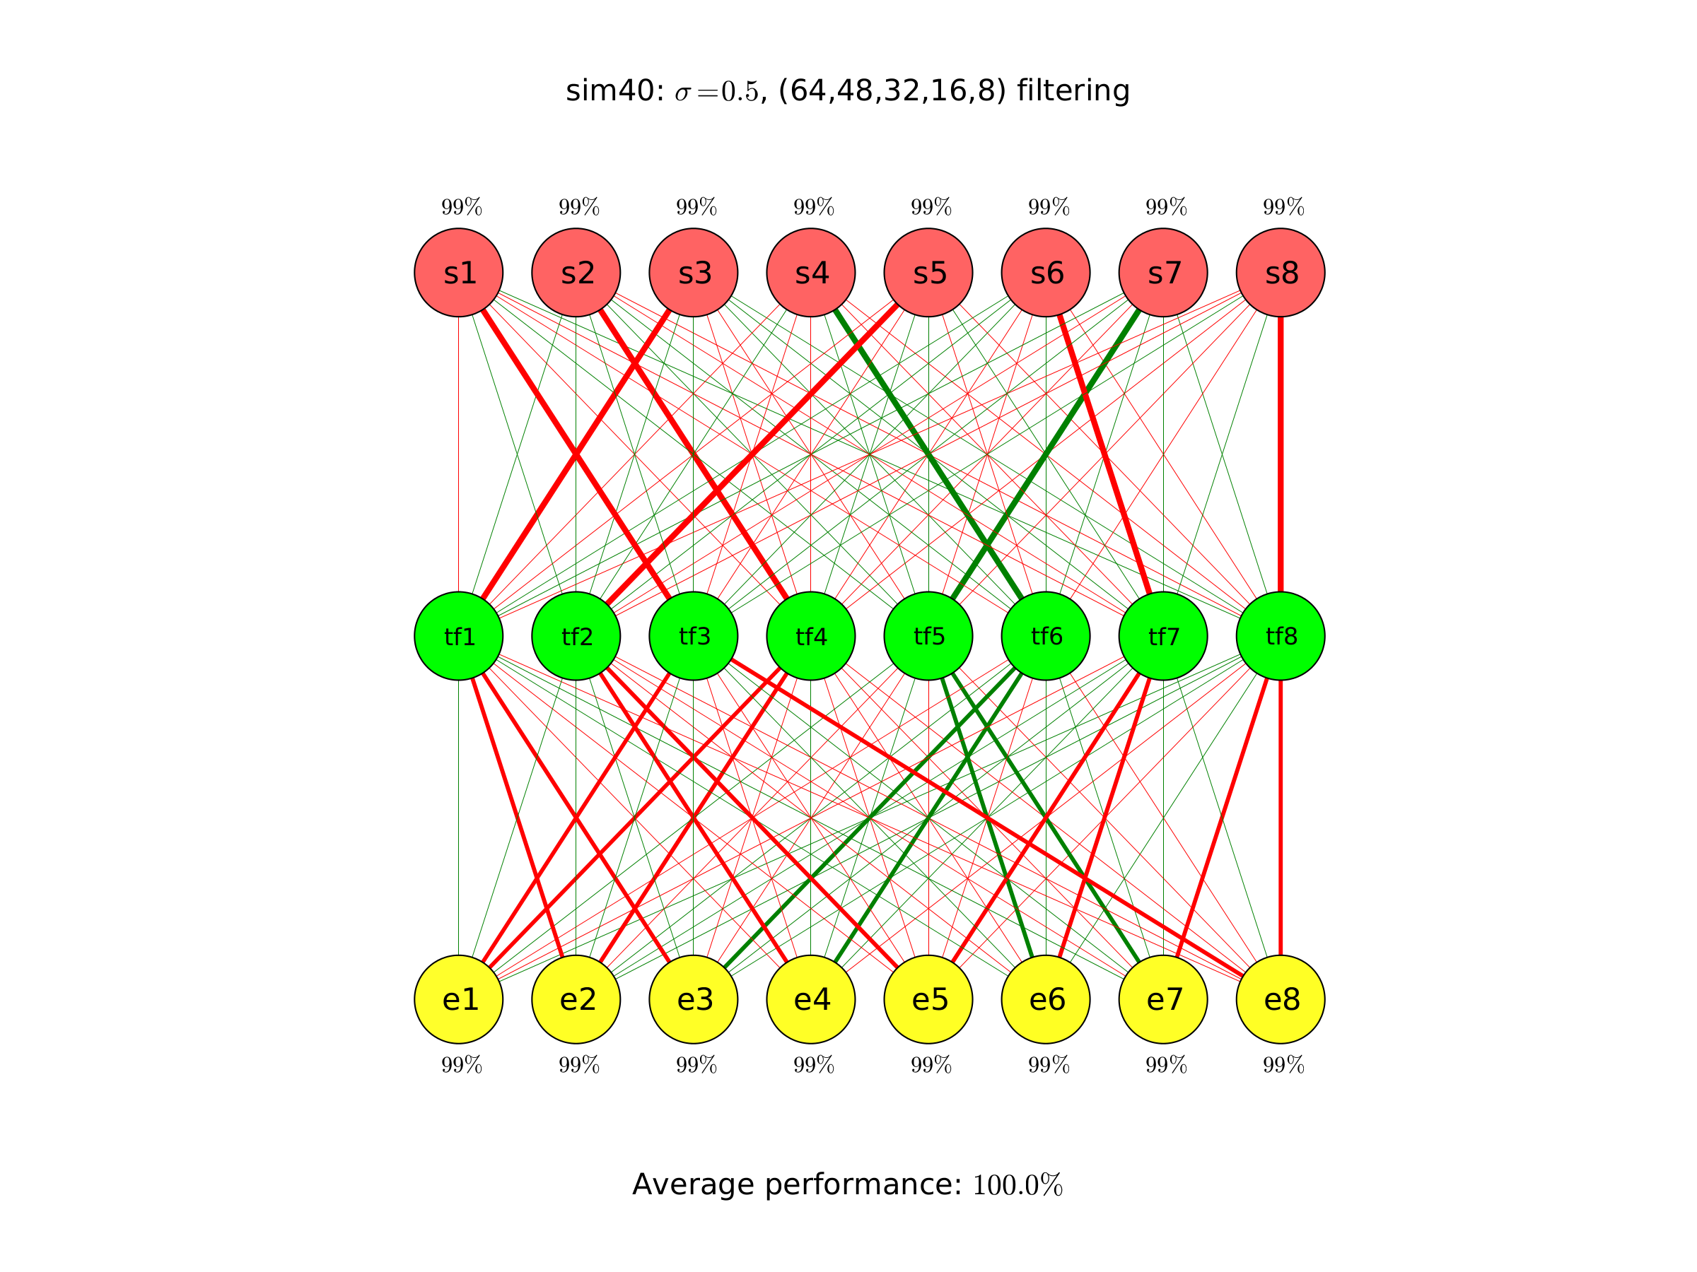
Results
Another Example with more nodes and larger autoencoder

Slide 74
Conclusion
Conclusion
Autoencoders can improve modeling significantly by reducing the dimensionality of data
Autoencoders preserve complex structures in their multilayer perceptron network. Analysing those networks (for example with knockout tests) could give more structural information
The drawback are high computational costs Since the field of deep learning is getting more popular (Face recognition / Voice recognition, Image transformation). Many new improvements in facing the computational costs have been made.

Slide 75

Acknowledgement
eilsLABS
Prof. Dr. Rainer König
Prof. Dr. Roland Eils
Network Modeling Group

